Slide 1
Analytical and Empirical Characterization of Hybrid Rocket Swirl Injection
Presenters: Matt H. Summers
Advisor: James K. Villarreal

Slide 2
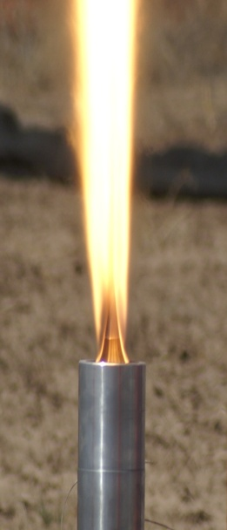
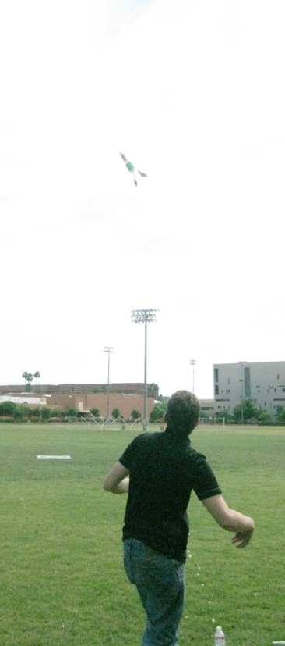
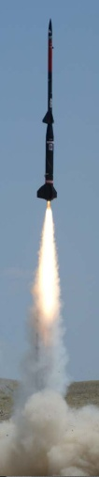
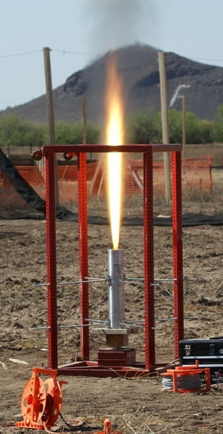
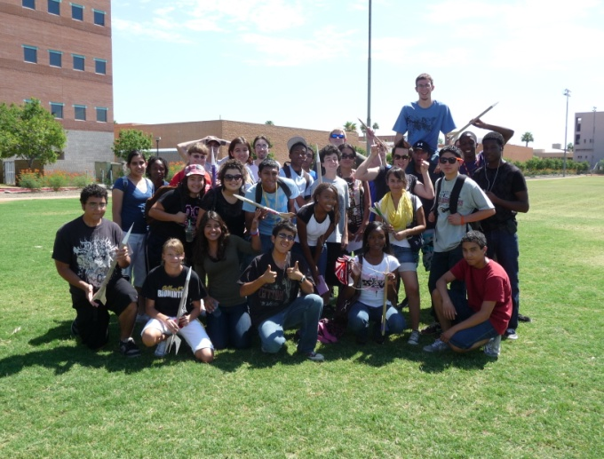
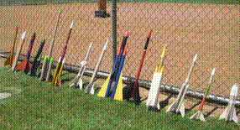
Daedalus Astronautics
Dual Purpose:
Teaching rocketry and basic physics to k-12 students
Advanced propulsion research/Sounding rockets
Daedalus Astronautics

Slide 3
Project Motivation
Analytics:
Preliminary computational fluid dynamic analysis
rapid results
Low cost
Empirical:
Minimized testing – Low cost
Develop an empirical characterization of hybrid swirl injection
Future Work:
Ability to test multiple components of a Hybrid Rocket Motor
Long-term, low-cost, easy apparatus
Great predictor for future research
Daedalus Astronautics

Slide 4
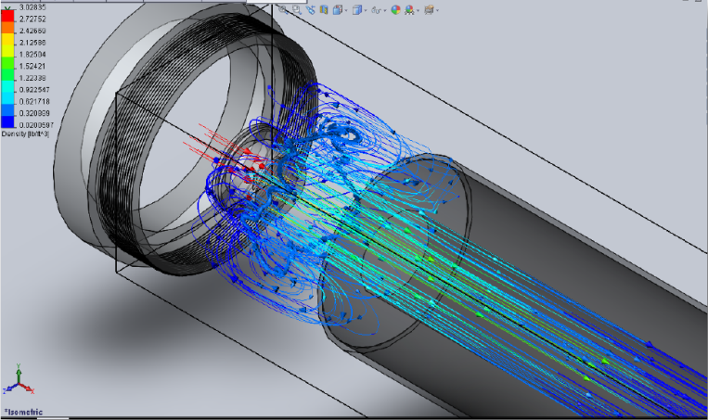
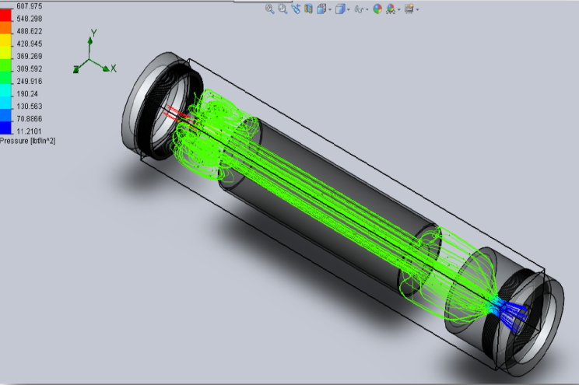
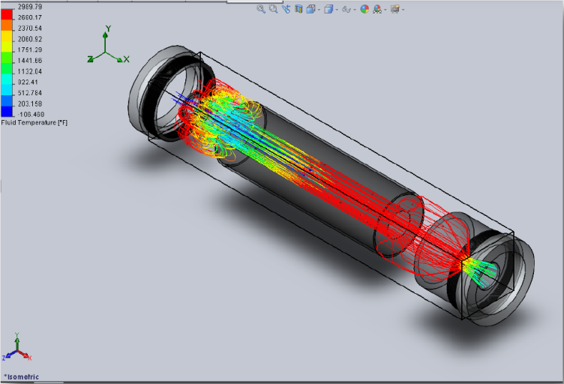
Analytics
Results:
600 psi Tank Pressure
400 psi chamber pressure
Turbulent flow achieved
Increased oxidizer mass flux
CTRZ: Central Toroidal Recirculation Zone
Figures shown are using a 60° super-critical injector.
Top-Right: Density distribution in CTRZ flow structure.
Bottom-Right: Constant pressure distribution in HRM.
Left: Varying Temperature distribution in HRM.
Daedalus Astronautics

Slide 5
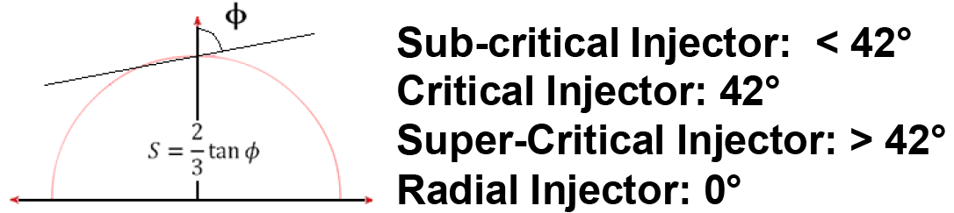
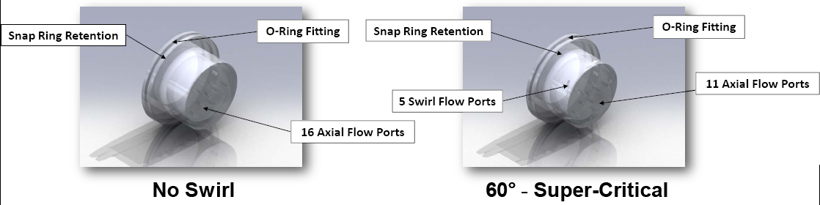
Design
Selected Injectors:
No Swirl
0° Swirl
15° Swirl
20° Swirl
30° Swirl
35° Swirl
42° Swirl
60° Swirl
Figure here shows how hybrid swirl injectors are classified based on their radial injection angle.
Daedalus Astronautics

Slide 6
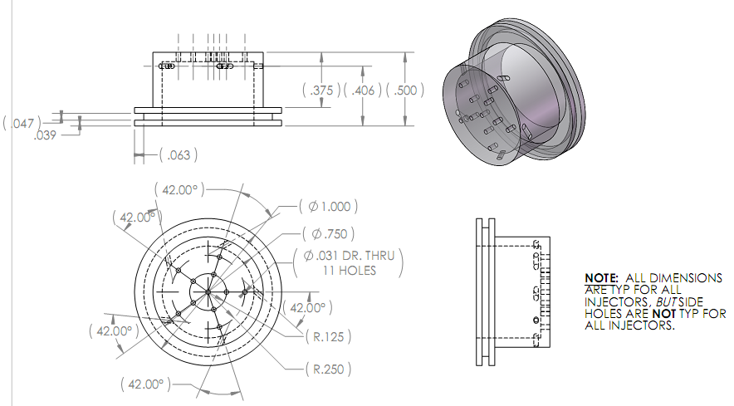
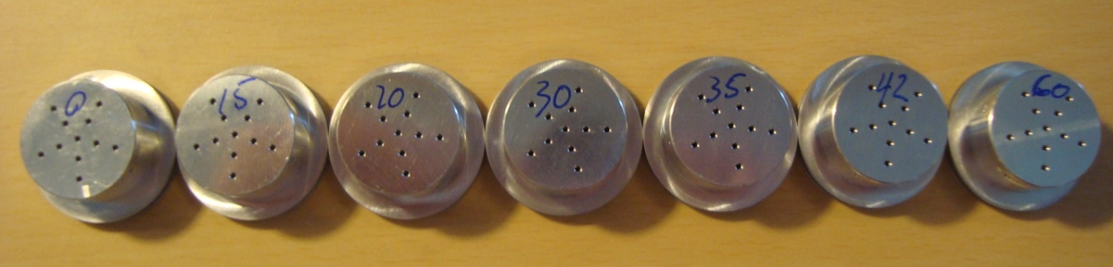
Fabrication
Selected Injectors:
No Swirl
0° Swirl
15° Swirl
20° Swirl
30° Swirl
35° Swirl
42° Swirl
60° Swirl
Example of print created for the 42° swirl injector
Machined injectors with their respective swirl angles
Daedalus Astronautics

Slide 7
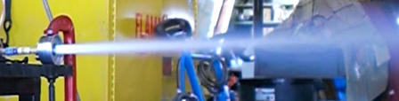
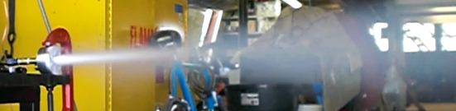
Cold-Flow Testing
Results:
No Swirl Test
  2 sec test
  0.6 lb ∆M in Tank
  Mass Flow Rate = 0.3 lb/s
  No CTRZ
60° Swirl Test
  2 sec test
  0.6 lb ∆M in Tank
  Mass Flow Rate = 0.3 lb/s
  CTRZ Formation
No CTRZ present – no pre-heating
Flow of No Swirl Injector
Flow of 60° Swirl Injector
Forward Enclosure deflects swirl flow to initiate CTRZ
Daedalus Astronautics

Slide 8
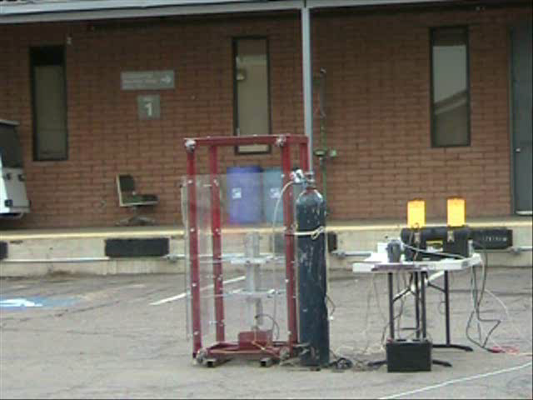
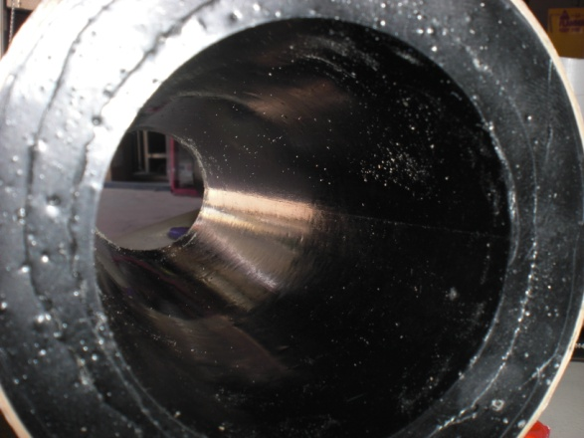
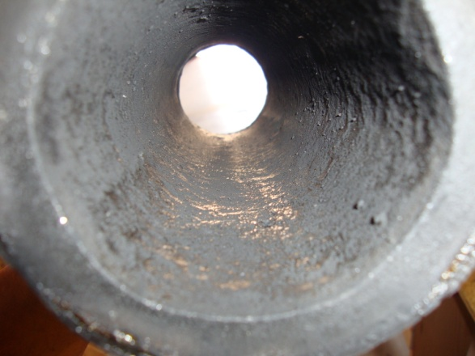
Hot-Fire Testing
Upon completion of the motor case.
Before
Testing of Full-Scale Hybrid Rocket Motor on Campus
After
Daedalus Astronautics

Slide 9
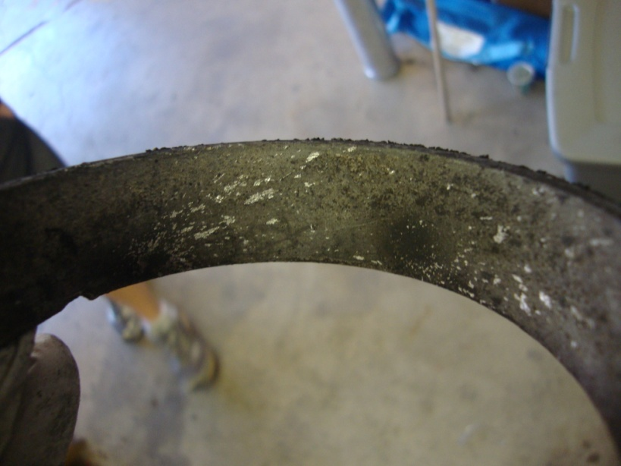
Empirical
Swirl Flow passing through the Pre-Combustion Chamber
Current Equation for regression rate of HTPB fuel grain
Potential Equation for regression rate of HTPB fuel grain
Daedalus Astronautics

Slide 10
Questions?
Daedalus Astronautics

